Slide 1



AI-Enabled Conversational IVR
Revolutionizing Customer Interaction
INFOSYS SPRINGBOARD- BATCH 3

Slide 2

Introduction
Traditional IVRs are rigid, frustrating, and lack context.
Moving from "Press 1 for Accounts" (DTMF) to "How can I help you?" (Natural Language).
Integrating Generative AI to create human-like, intuitive voice interactions.
Presented By : Buela, Sneha and Harika

Slide 3

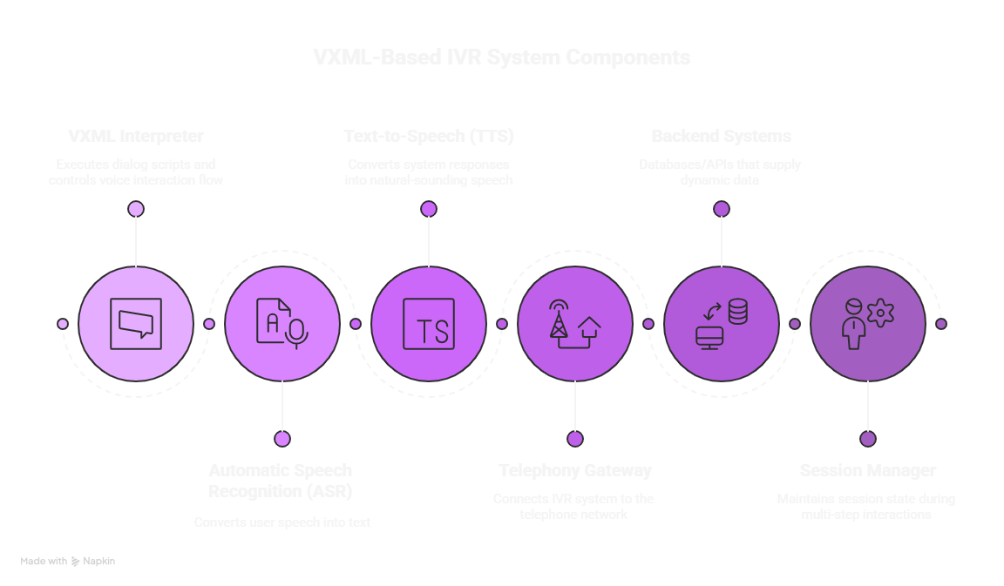
Architecture
Presented By : Misha and Santhosh

Slide 4

Project Overview
1.
To develop a modern framework that modernizes legacy VXML systems.
2.
Converting voice input to text, processing it via AI, and responding with synthetic voice.
3.
Dynamic responses based on user intent, not pre-recorded static menus.
Presented By : Nazia, Ashish and Priyadarshini

Slide 5

Project Milestones
Initial Research
Core Development
SYSTEM INTEGRATION
DEPLOYMENT & OPTIMIZATION
Built the backend framework and integrated the Generative AI engine for intent detection.
Connected the AI model with the Telephony Gateway and conducted functional testing.
Deployed the modernized IVR solution and optimized response latency for smooth interaction.
Conducted comprehensive market analysis for insights.
Presented By : Ashwin and Shruti

Slide 6

Applications
Presented By : Saranya, Anushka and Rohan

Slide 7
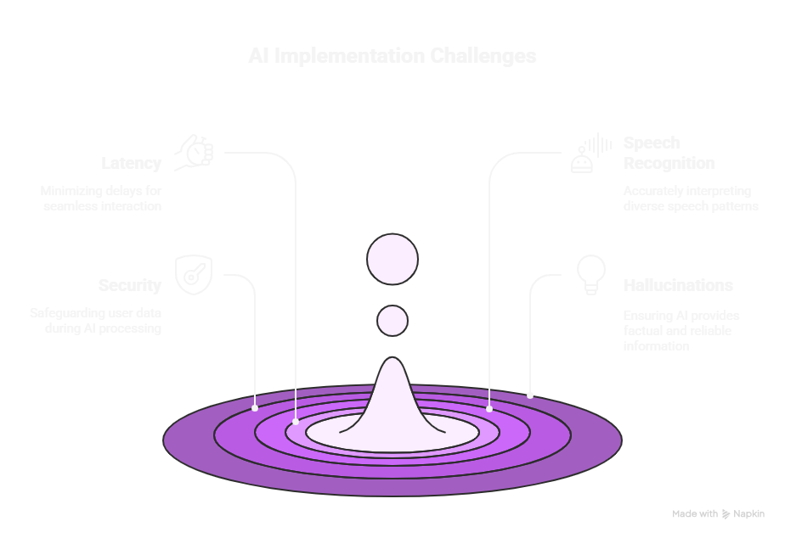
Challenges
Presented By : Manoj, Ammutulhusna Mohammad and Praveen

Slide 8



Future Scope
Omnichannel: Switching the conversation from Voice to WhatsApp/SMS seamlessly.
Sentiment Analysis: Detecting user emotion (anger/joy) to route calls to humans if needed.
Multilingual Support: Real-time translation for regional languages.
Presented By : Gayatri and Sonakar Khushi

Slide 9
Conclusion
Modernized IVR enhances User Experience (UX) and operational efficiency.
Reduces wait times and operational costs.
Scalable framework adaptable to any industry.
Presented By : Dimpul, Harshvardhan

Slide 10


Thank You

